Slide 1
Cementing the Foundations for Inclusive Globalization
By Michael Siebel

Slide 2
Indicators
Equality
Gini Coefficient
Source - World Bank: World Development Indicators
Trade Openness
Total Exports plus Total Imports over GDP
Source - World Bank: World Development Indicators
Financial Deepening
Total External Assets plus Total External Liabilities over GDP
Source - External Wealth of Nations Database
Technology Investment
Total Information Communication Technology Stock over Total Capital Stock
Source - The Conference Board: Total Economy Database

Slide 3
Additional Indicators
Population Density
People per sq. km of Land Area
Source - World Bank: World Development Indicators
Capital
Share of Capital Stock as a Percent of GDP
Source - The Conference Board: Total Economy Database
Wealth
Per Capita GDP
Source - World Bank: World Development Indicators

Slide 4
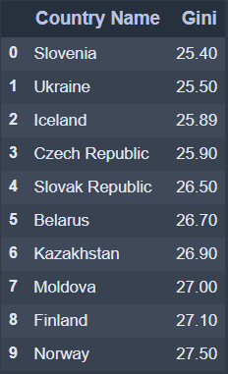
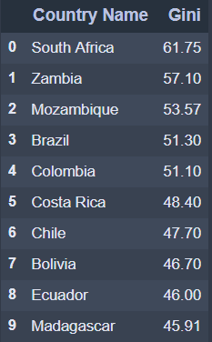
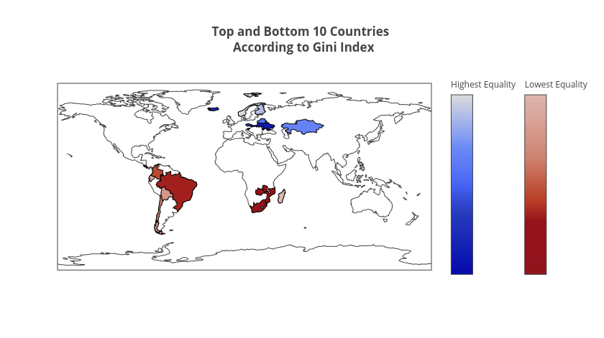
Top Ten Most and Least Equal Countries in 2015
Most Equal
Least Equal

Slide 5
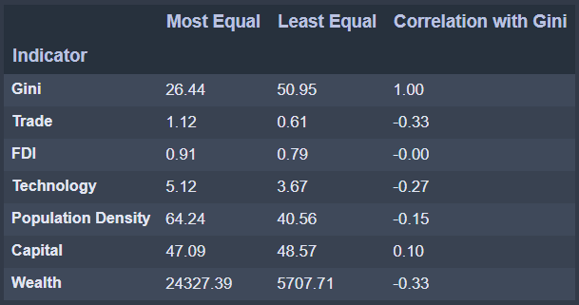
Average Statistics for Indicators
The most equal countries are more:
Open to trade
Investment in Technology
Densely populated
Wealthy on a per capita basis

Slide 6
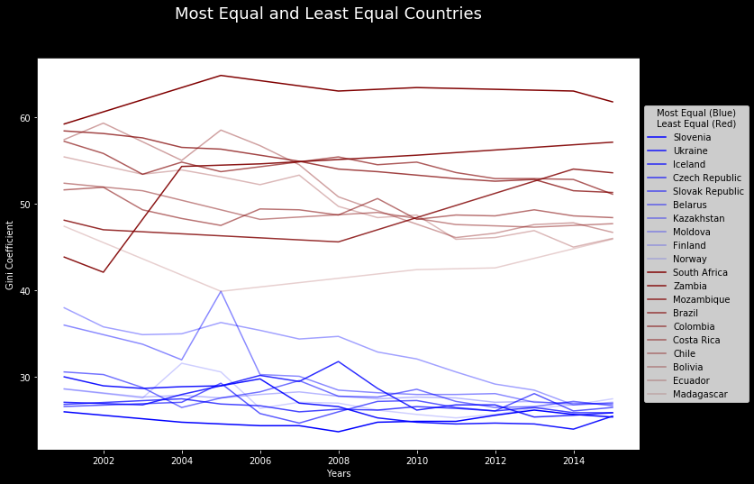
Gini Coefficient
Most equal countries decreased in their gini coefficient
Moldova decreased the most
Least equal countries have high variation
South Africa is far more inequal than other countries

Slide 7
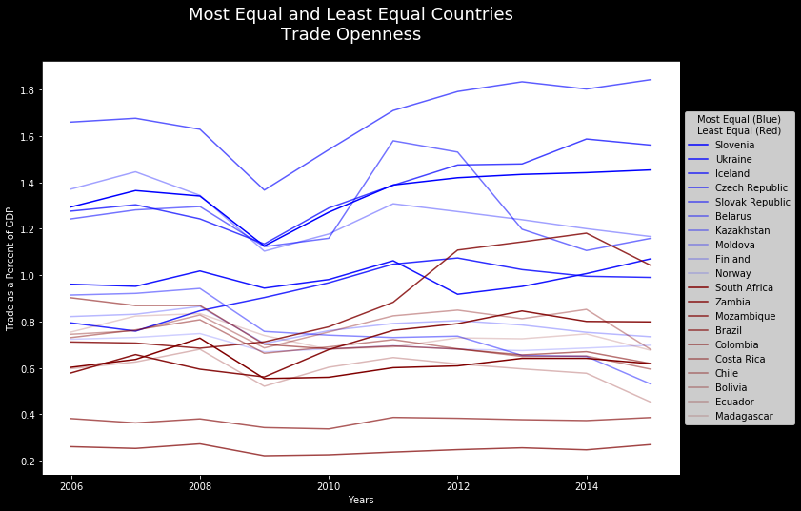
Trade Openness
Large distinction
Trade had sharp declines in 2009 following the recession
South Africa had large increase

Slide 8
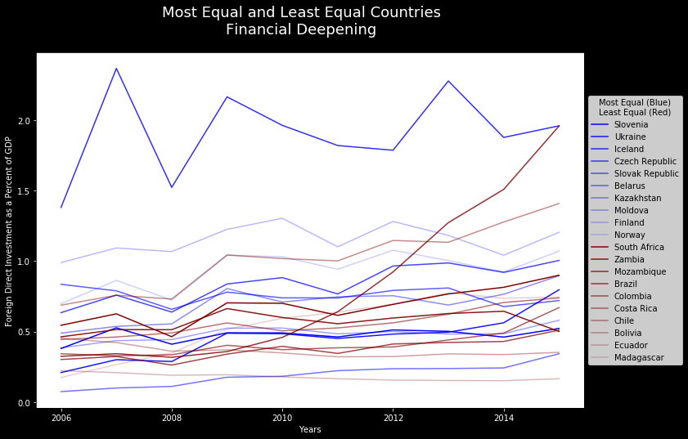
Financial Deepening
Almost no distinction
Iceland is clear outlier
Mozambique has had a dramatic increase

Slide 9
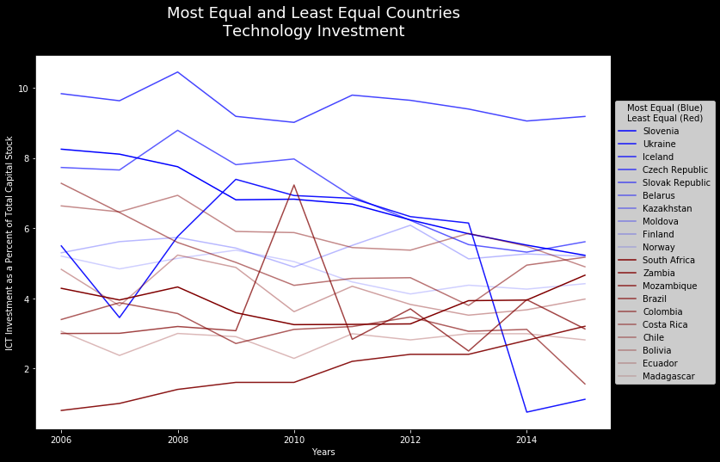
Technology Investment
Large distinction
Ukraine has had dramatic change since 2014
Coincides with Russian intervention

Slide 10
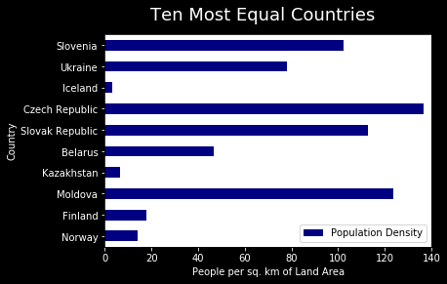
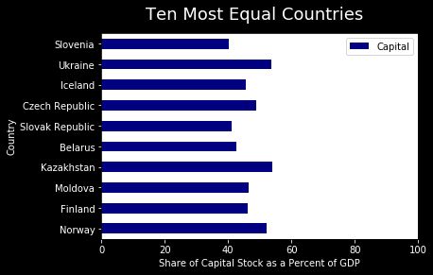
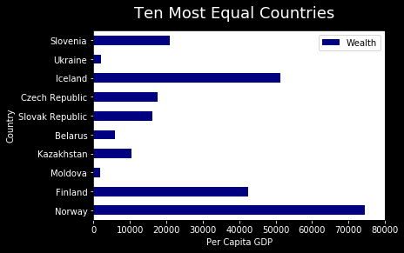
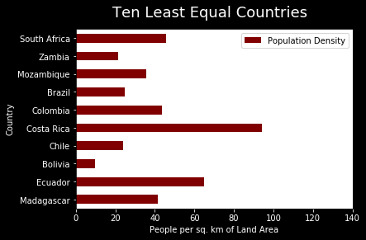
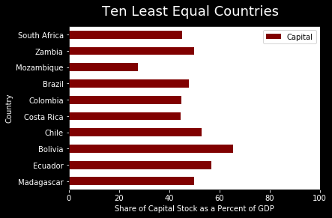
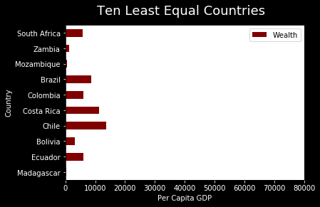
Population Density, Capital, Wealth

Slide 11
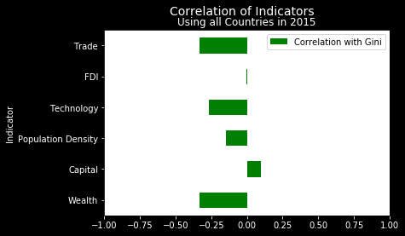
Conclusion
Trade, Technology, and Wealth are highest
FDI is lowest
Capital is only positively correlated
None are highly correlated

